Slide 1

Excel-R project-1 Time series Forecasting of Gold data
By Team 2

Slide 2
Data set Information
Gold price data set from 2016 to 2021
We have two columns date and price
We have total 2182 Entries from (0 to 2181)

Slide 3
Exploratory data analysis: Describe The Gold Data
Minimum gold price =2252.600000
Maximum gold price=4966.300000
Average gold price=3284.450046
Standard deviation of gold price =719.564434
The 25% percentile = 2697.020000
The 50% percentile = 2879.800000
The 75% percentile = 4147.325000

Slide 4

Average Gold price per Year
Year Price
2016 - 2697.985708
2017 - 2626.676484
2018 - 2781.938082
2019 - 3150.210685
2020 - 4227.930411
2021 - 4149.970959

Slide 5
-The Data set contains no missing values and no null values. -The datatype of the date is object which is converted to Date-Time format -There are no duplicates values. -There are no outliers in the dataset -Data is positive skewed and value is 0.637 and kurtosis value is (-1.24) (If a distribution has negative kurtosis, it is said to be platykurtic, which means that it has a flatter peak and thinner tails compared to a normal distribution)

Slide 6
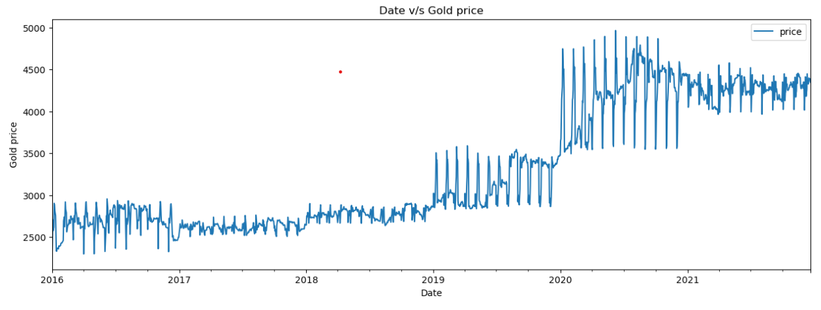
Plotting Year and Gold Price Upward Linear Trend

Slide 7
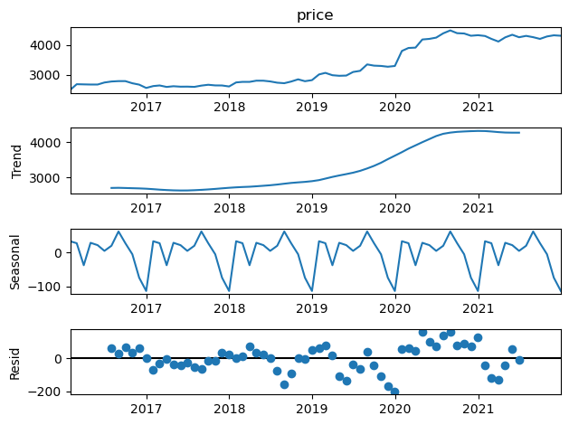
Trend and Seasonality:

Slide 8
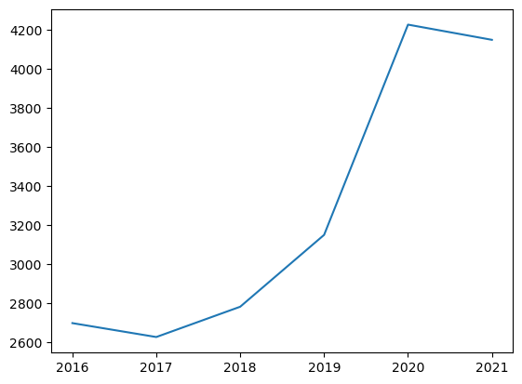
Price Vs Year

Slide 9
Test for stationarity of the data: H0=data is not stationary H1=data is stationary ADF Statistics: -0.30990365705047707 p- value: 0.9240899189079188 p is less than(<) 0.05 hence weak evidence against null hypothesis, time series has a unit root, indicating it is non-stationary

Slide 10
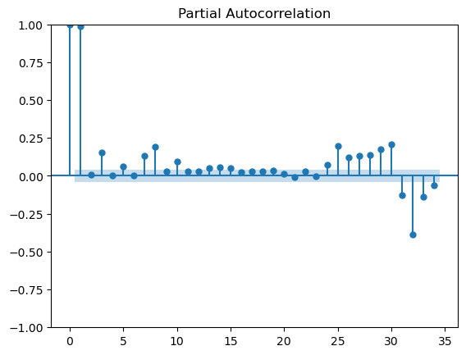
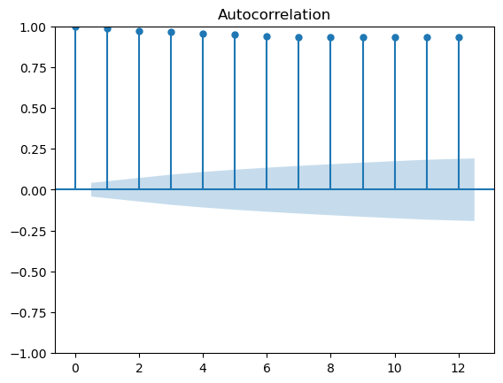
ACF and PACF plots

Slide 11
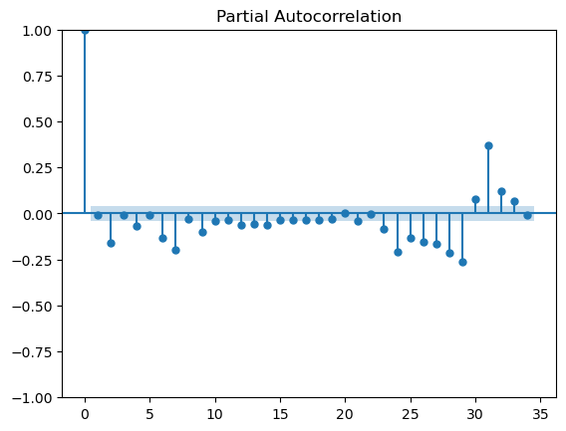
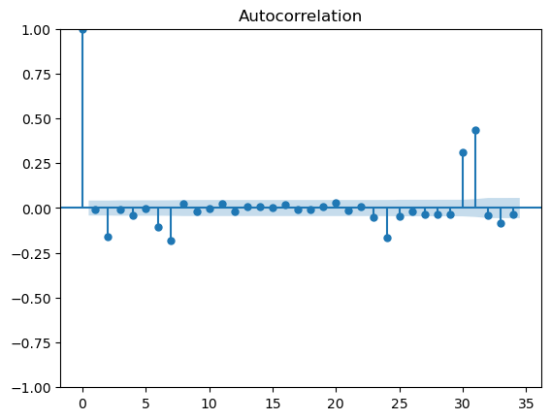
ACF and PACF for-price First Difference

Slide 12
Data driven Models
Simple Exponential Method
Holt method
Holts winter exponential smoothing with additive seasonality and additive trend
Holts winter exponential smoothing with multiplicative seasonality and additive trend

Slide 13
Models and MAPE values.
Model MAPE
ses_model 2.353934131154247
hw_model 3.1592148521546806
hwe_model_add_add 2.2285601080875135
hwe_model_mul_add 2.846087022662996

Slide 14
Model Based
linear model
Exponential
Quadratic
Additive seasonality
Additive Seasonality Quadratic
Multiplicative Seasonality
Multiplicative Additive Seasonality

Slide 15
Models and Rmse-values
 | MODEL | RMSE_Values
0 | rmse_linear | 103.154437
1 | rmse_Exp | 144.416407
2 | rmse_Quad | 533.944176
3 | rmse_add_sea | 1139.346288
4 | rmse_add_sea_quad | 452.653068
5 | rmse_Mult_sea | 1206.451631
6 | rmse_Mult_add_sea | 96.560192

Slide 16
We have imported pickle library and used dump method to save the model as pickle file.
Of all the models Holts winter exponential smoothing with additive seasonality and additive trend also known as the Triple Exponential Smoothing method is selected for forecasting as the error is minimum when compared to other models.
Auto arima model has also been done and gave good result but couldn’t use due to memory issue.

Slide 17
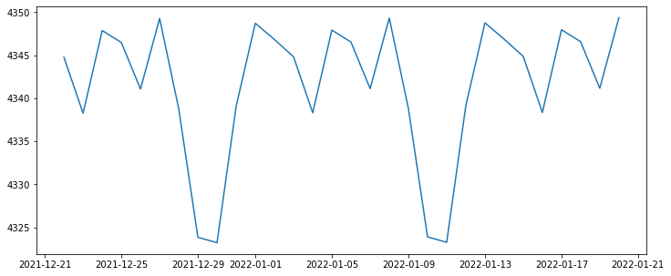
Gold price forecast using Hwe model for next 30 days

Slide 18
Using the load method of pickle library the model is read and saved in a variable using which the next 30 days forecast of gold price was done.
Application was built using Streamlit where the user has the option to select the number of days to be forecasted.
On selecting the required number of days and hitting the get predictions button forecasted gold prices for that particular period will be displayed as a dataframe.
Also graph representing the forecasted gold prices can also be seen.

Slide 19
Finally the code is pushed to github and deployed using Streamlit itself.
The deployment links are as follows:
Link1: Streamlit (gold-price-forecast-excelr.streamlit.app)
Link2 : Streamlit (forecastgoldprice-7vwktoijuwl.streamlit.app)

Slide 20
Thank you
Done by:-
Group-2
B Nagarjuna Babu , M V S K Karthik
Babar ,Sanket Sanjay Kale
Vinayakam Amrutha , Ananthoju Richitha
Tushar Tidke

